Slide 1
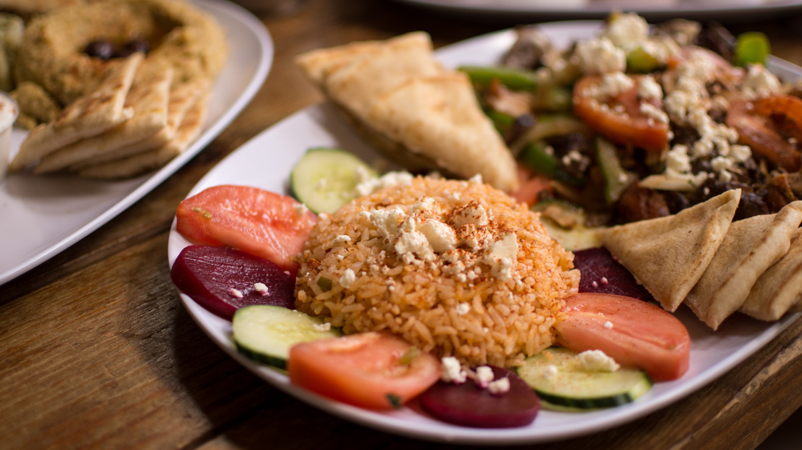
Appetizer Restaurant & Cafe
A taste you‘ll remember.

Slide 2

WELCOME TO MY PRESENTATION
Appetizer restaurant and cafe
Anika Tahseen Maliha
Batch 54
Department of law

Slide 3
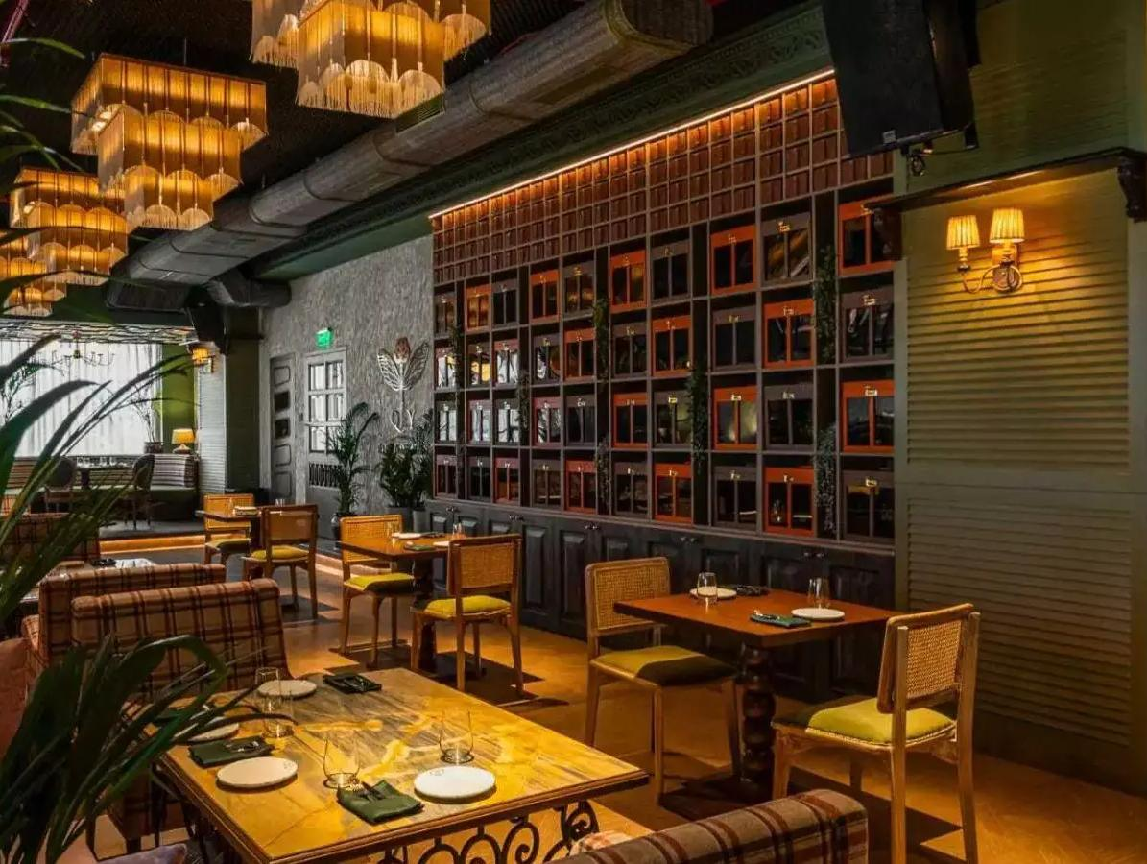
Introduction
Welcome to Appetizer Restaurant & cafe , where culinary excellence meets a warm and inviting atmosphere. Established in 2020 in Dumki, Patuakhali .Our restaurant is dedicated to providing an unfor -gettable dining experience for all our guests. Whether you’re here for a casual meal with friends, a romantic dinner, or a special celebration, Appetizer Restaurant offers the perfect setting.

Slide 4
MISSION
Serve good food
Maintain quality
Client satisfaction

Slide 5
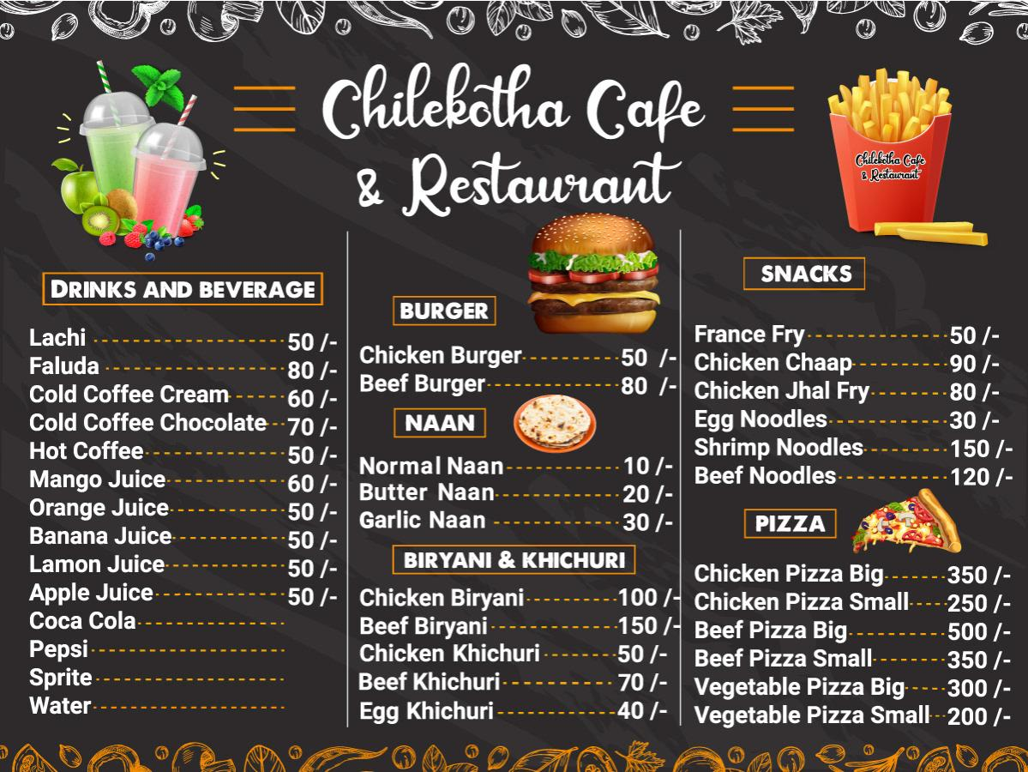
Menu
Appetizer
Restaurant &cafe

Slide 6
Most Popular Menu Categories at AB Restaurant

Slide 7
THANK YOU

